Slide 1
3M6M12M Introduction
システムチーム

Slide 2
A．What is 3M6M12M?
※A new function allowing members to buy future orders in bulk and save shipping fees .
※Members can choose 3M6M12M up to 3 years to avoid forgetting to place orders.
※Getting extra products as presents for the same price.
※Purchase plans : 3Mx1, 3Mx2, 6Mx1, 6Mx2, 12Mx1, 12Mx2
Eg. 3Mx1: Purchase 1 box/month for 3 consecutive months

Slide 3
Purchase plans
Purchase plans | 3Mx1 | 3Mx2 | 6Mx1 | 6Mx2 | 12Mx1 | 12Mx2
Product Qty | 3 boxes | 6 boxes | 6 boxes | 12 boxes | 12 boxes | 24 boxes
Gift Qty | 0,5 box | 1 box | 1 box | 3 boxes | 3 boxes | 7 boxes
Product price | 40,500JPY | 81,000JPY | 81,000JPY | 162,000JPY | 162,000JPY | 324,000JPY
PV distribution | 12,000 PV X 3 months | 24,000 PV X 3 months | 12,000 PV X 6 months | 24,000 PV X 6 months | 12,000 PV X 12 months | 24,000 PV X 12 months
Total PV | 36,000 | 72,000 | 72,000 | 144,000 | 144,000 | 288,000
Shipping method | ship all after purchase | ship all after purchase | ship all after purchase | ship all after purchase | ship all after purchase | ship all after purchase
Notes:
Purchase Notice:
* All product prices are exclusive of shipping fees.
* ONE shipping address per order, Separate shipments are not accepted.

Slide 4
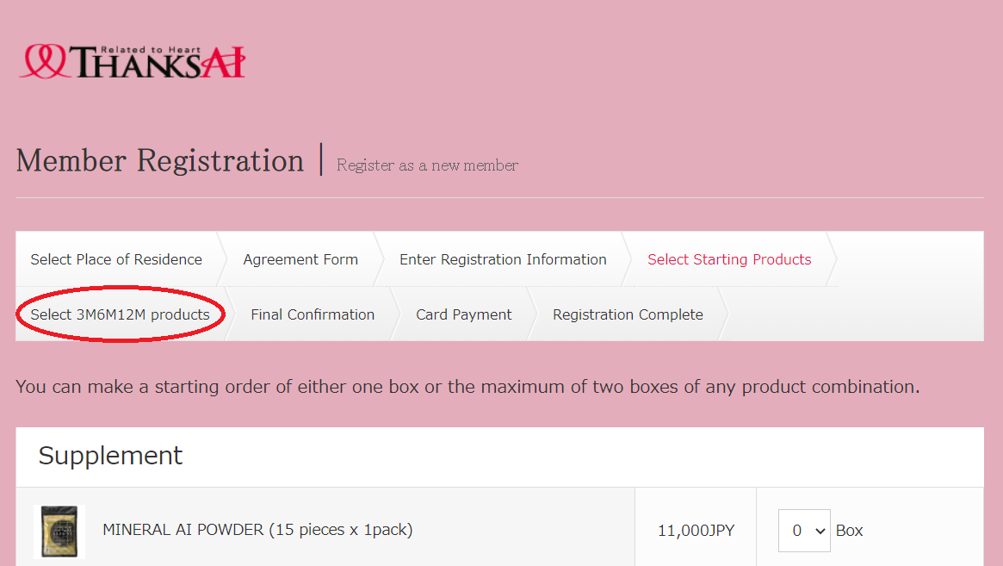
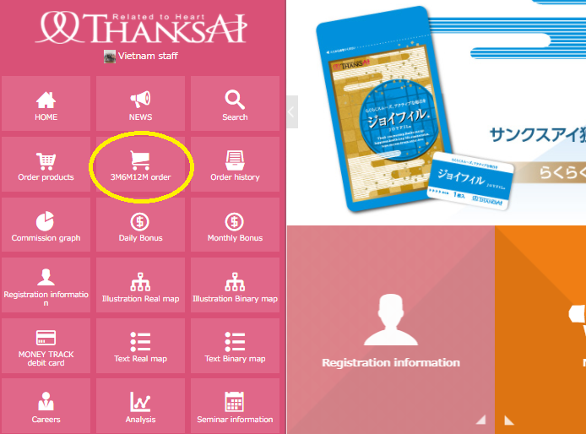
B. Where to purchase 3M6M12M?
1. Registration page
2. Backoffice

Slide 5
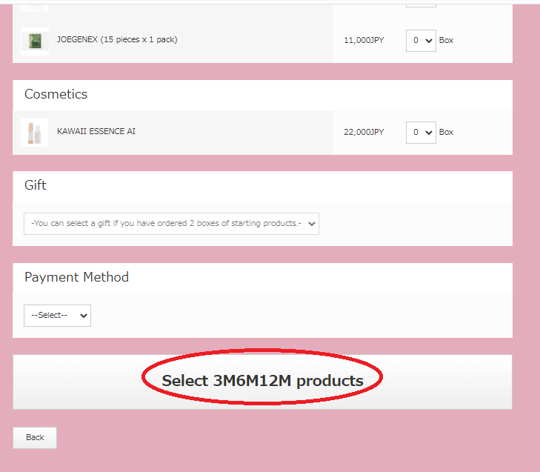
B. Where to purchase 3M6M12M?
1. Registration page
※ For new registrations.
Note: 1 box purchase combined by 2 different half products is acceptable
E.g. （○）0,5 Joyfil box+0,5 JoeGenEx
※ After finishing 「select starting product」, you can click on 「 Select 3M6M12M products 」.

Slide 6
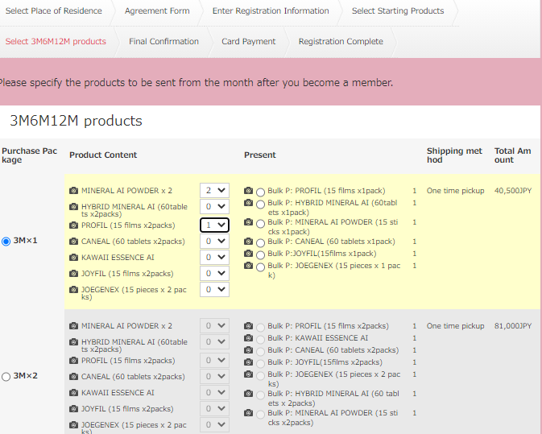
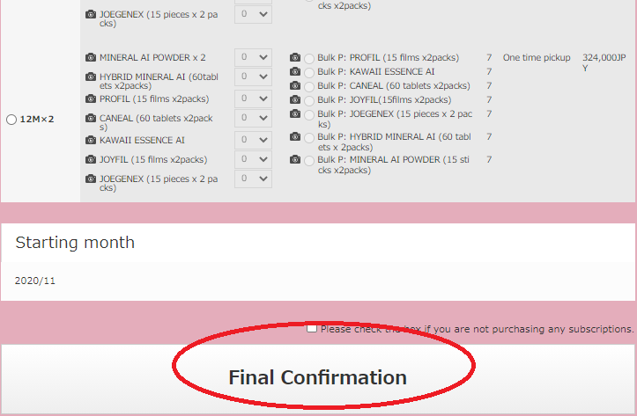
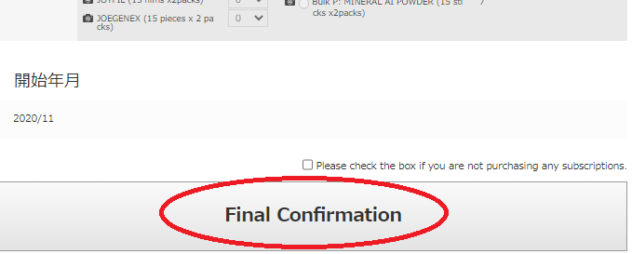
B. Where to purchase with 3M6M12M?
1. Registration page
Step 1. Choose purchase plan, then products and present.
Step 2. Then click 「final confirmation」 to proceed.
Note: Only 1 plan can be chosen.
Note: This 3M6M12M order starts next month
If 3M6M12M is not necessary, check the check box.
Notes:
Notes:
3M6M12M products will be sent at the same time with starting products.
If you purchase 3M6M12M from the registration page, the starting month will be the following month after you become member.
E.g. If you register in October and choose to purchase 3M6M12M. The system will record that that the 3M6M12M product is ordered starting from November.

Slide 7
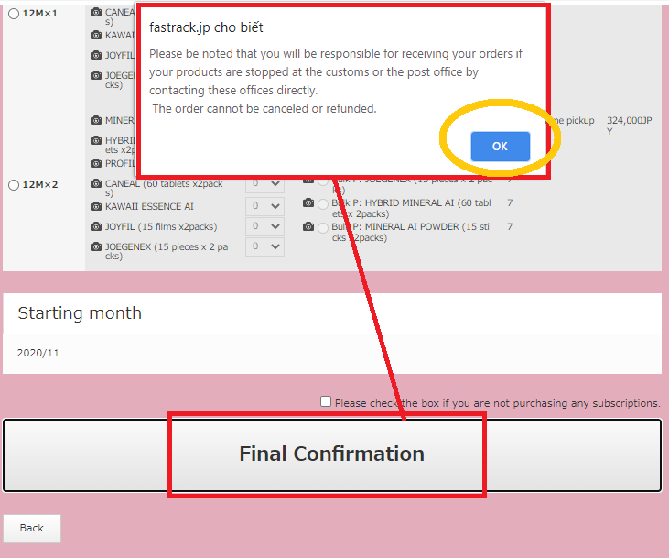
B. Where to purchase with 3M6M12M?
1. Registration page
Step 3. After clicking 「Final Confirmation」, a warning message about custom and refund will pop up.
“Please be noted that you will be responsible for receiving your orders if your products are stopped at the customs or the post office by contacting these offices directly. In the order cannot be canceled or refunded.
If you agree, click “Ok” to proceed.

Slide 8
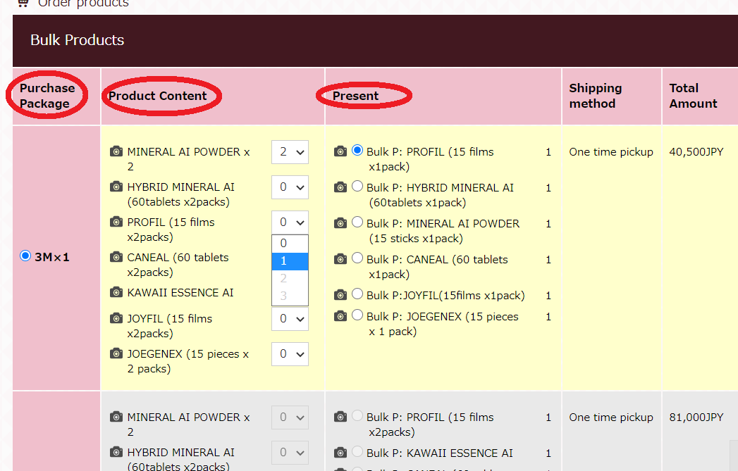
B. Where to purchase with 3M6M12M?
2. Backoffice
Step 1. After login click on 「3M6M12M Order」
Step 2. Choose purchase plan and products and present
Note: only 1 purchase plan can be chosen at a time

Slide 9
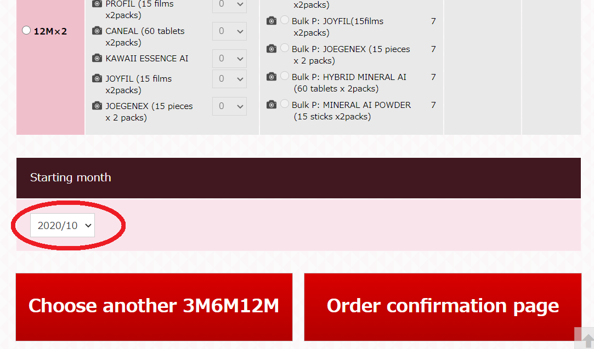
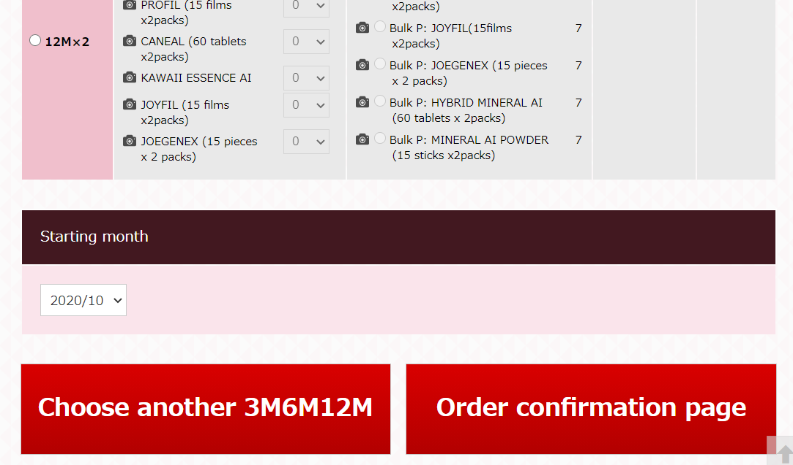
B. Where to purchase with 3M6M12M?
2. Backoffice
Step 4. Click on「Choose another 3M6M12M」to buy a new 3M6M12M or 「Order confirmation page」to proceed
Step 3. Choose starting month
Click here to buy more 3M6M12M
Click here to confirm order & proceed

Slide 10
C. Shipping method & shipping fee:
※The shipping method
+ is the same as in the 「Select starting product」 during registration.
※The shipping fee
+ No matter how many 3M6M12Ms members buy at the same time, the shipping fee remains the same
+ One time shipping fee will be applied.
+ The products purchased will be shipped all at once

