Slide 1
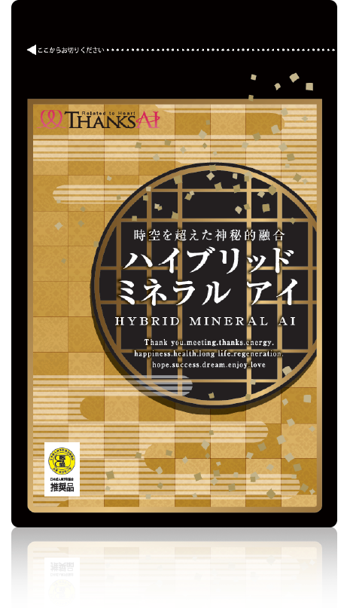
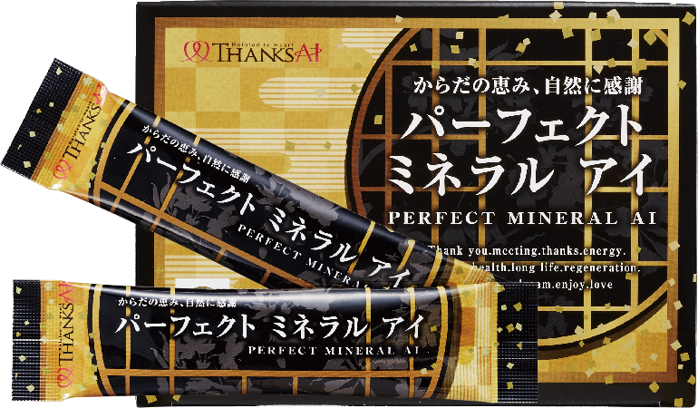

Slide 2
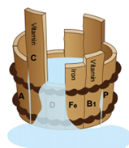
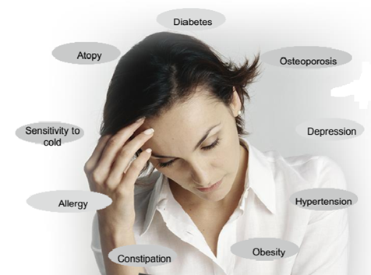
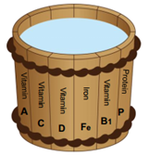
Low Absorption Capacity
Unbalance minerals
Unhealthy body
Absortion about 10 – 40%
High Absorption Capacity
Balance minerals
Healthy body
Absortion about 98%

Slide 3
HOW CAN WE BALANCE MINERAL FOR OUR HEALTH
Perfect Mineral AI and Hybrid Mineral AI
Contain ingredients which provide minerals for our bodies
Ingredients are easy to absorb to our bodies
Can help balance necessary vitamins and minerals in our bodies

Slide 4
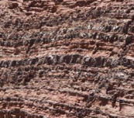
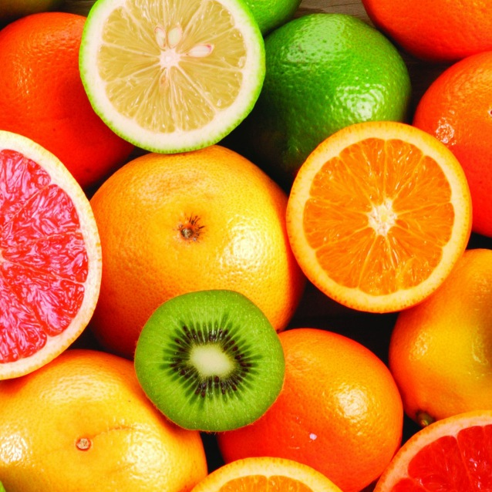
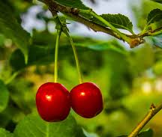
INGREDIENTS Perfect Mineral AI
silicon
acerola
citric acid
fulvic acid
Where do they come from?
vitamins

Slide 5
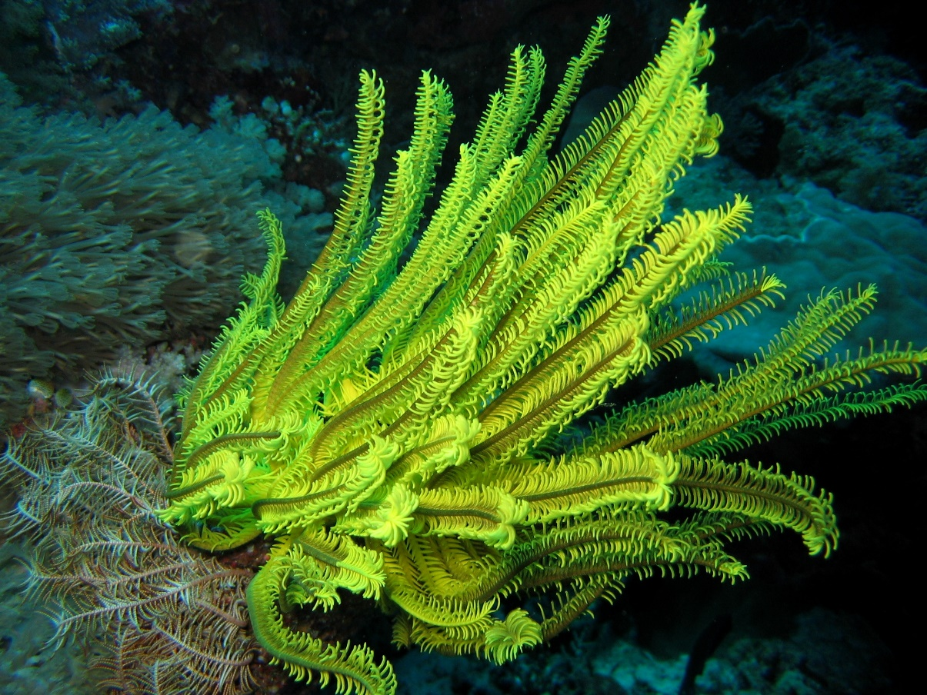
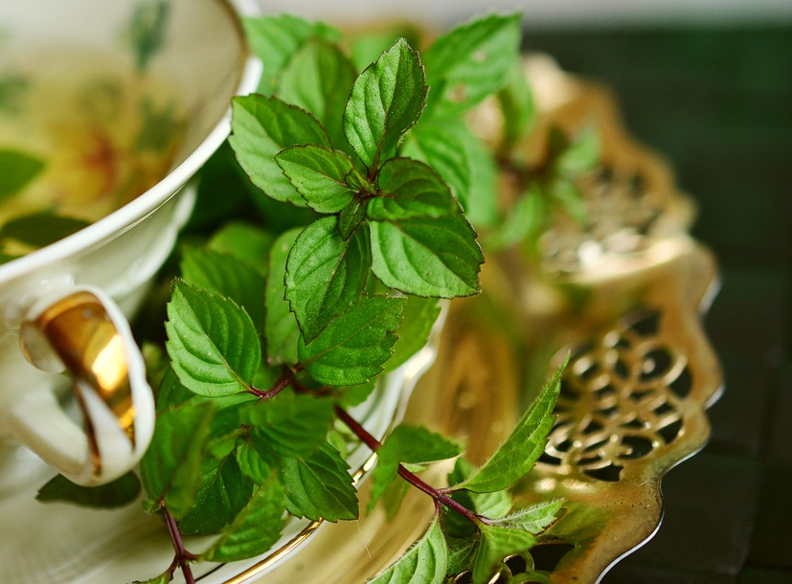
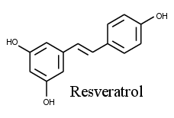
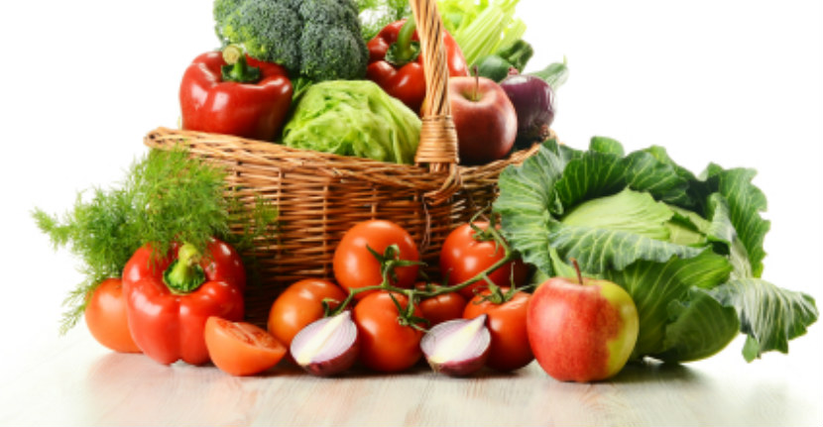
INGREDIENTS Hybrid Mineral AI
Minerals from ancient plant-derived layer
Resveratol
Replan mineral
Tree leaves
Seaweed
Japanese herbs

Slide 6
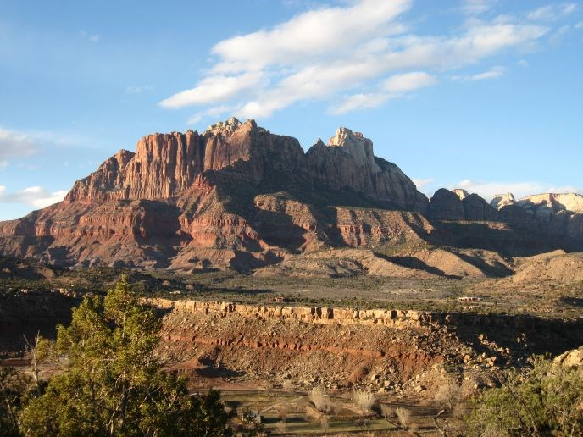
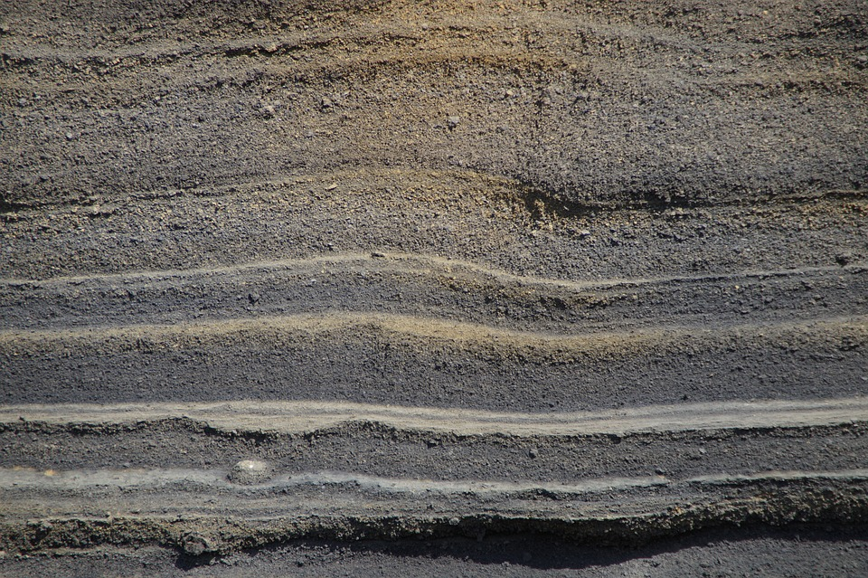
THE ANSWER IS…
Extracted from the ancient plant-derived sedimentary layer which has existed for about 100 million years ago
Mineral content is extracted from the ancient plant-derived sedimentary layer
And now it appears in…

Slide 7
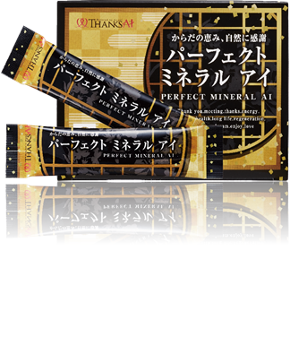
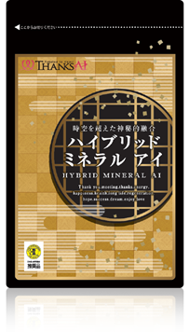
Perfect Mineral Ai
Vegetable mineral-containing food
Nutritional information:
Calories: 6.38kcal
Protein: 0.022g
Lipid: 0.014g
Carbohydrate: 1.542g
Sodium: 1.704mg
Hybrid Mineral Ai
Vegetable mineral-containingfood
Nutritional information:
Calories: 10.56kcal
Protein: 0.55g
Lipid: 0.84g
Carbohydrate: 0.19g
Sodium: 14.05mg
The Ideal Minerals for
Health and Beauty

