Slide 1
PLANT-BASED MINERAL
Plant-based minerals is a general term for minerals that plants absorb through their roots from traditional minerals in the soil, modified by photosynthesis into a state that is easy and safe for living things to use.

Slide 2
The Difference between
Plant-based Mineral
and
Traditional Mineral
Traditional Mineral
Created by pulverizing or processing husks or salts in things like rocks, limestone, or oyster shells.
Contained in the soil are made of large particles, making them difficult for our cells to absorb.
Possess inferior nutritional balance, which risks being harmful to the body if consumed in excess.
Are most minerals sold on the market.
Plant-based Mineral
Consists of over 70 varieties of well-balanced minerals
supplies the body with nutrients
effective in expelling harmful minerals from the body.
Quantities of minerals in modern diets have diminished, so for modern consumers who have fallen into a trap of chronic mineral deficiency, it is ideal to be able to safely consume plenty of minerals.

Slide 3
Plant-based minerals, once absorbed by plant, are about 7000 times smaller than red blood cells.
Therefore, they become easy to be absorbed into the body. The absorption rate reaches 98%.
Whereas, researches show that the plant-based mineral absorption rate of normal mineral products only reach 10-40%.
High absorption rate of
98%

Slide 4
A miracle substance
acts as a transporter for minerals to cells
enveloped in a variety of minerals
FULVIC AXIT
neutralizes harmful minerals that accumulate in the body and eject them
contributes to a high absorbency rate

Slide 5
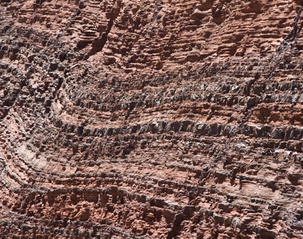
THANKS AI’s safe, superior quality plant-based mineral resources
Humic shale minerals
The noble path of plant-based minerals Ancient miracle plant-based minerals
Modern plant-based minerals/Replan
Modern plant-based minerals The ultimate antioxidants and diet minerals
Humic shale fulvic acid
The treasures of high quality fulvic acid Contains an abundance of precious fulvic acid

Slide 6
Product of Utah, USA
Humic shale extracts
Humic Shale Minerals
Plant-sourced and extremely safe
Excellent mineral balance
98% absorption rate
Over 70 kinds of minerals

Slide 7
Humic Shale Fulvic Axit
Humic shale extracts
Product of New Mexico, USA
Drawing out the maximum benefits of plant-based minerals
Like the diamond of ancient plant-based minerals
Features an abundance of extremely rare, precious fulvic acid
Has an excellent ability to weed out what is necessary and what is not

Slide 8
Modern plant-based minerals/Replan
Are ultimate diet minerals carefully extracted from the ashes that are a result of processing 13 kinds of Japanese wild grasses, leaves of trees and shrubs, and seaweed at high temperatures to a magma state, completely removing the oxygen.
Are packed with wild growth restoring and emulsifying powers, and endowed with the vitality of the wildly growing plants native to Japan.
・Modern domestic plants ・Wild growth restoration ・Wild growth emulsification

